Slide 1
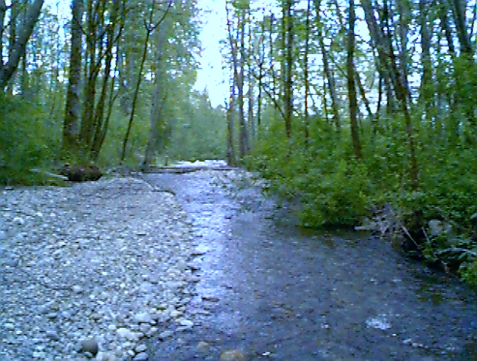
Flow-Ecology Relationships and Applications to Stormwater Management
Curtis DeGasperi
King County DNRP, WLRD
University of Washington
Hydraulic Design for
Environmental Engineering
March 9, 2021
Notes:
Questions during presentation welcome. This is a whirlwind tour of the kind of work we do plus some historical background and context.

Slide 2
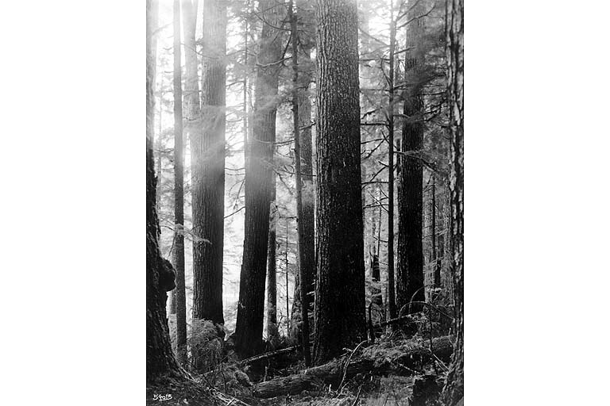
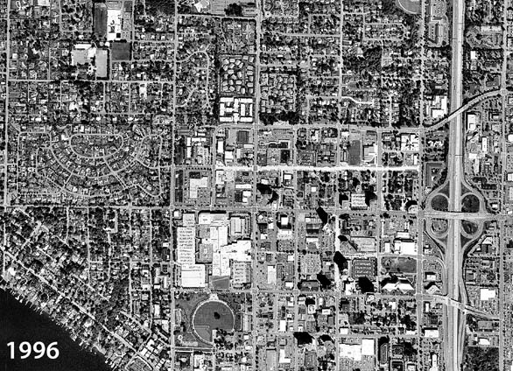
Human Impacts on Water Cycle
Land cover change
  Forest clearing/Development
~1880
Notes:
Historically dense tree canopy and accumulation of soil organic matter that stored lots of water. Now (using downtown Bellevue in 1996 as an example) we have impervious roads, rooftops, parking lots and compacted grassy areas that don’t store much water and generate runoff quickly.

Slide 3
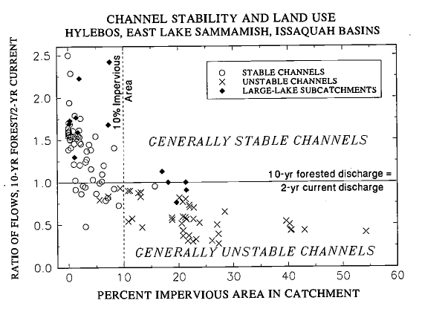
Stormwater Hydrology 101
Vegetation clearing
Soil compaction/removal
Ditching and draining
Covering of land with impervious roofs and roads
  Results in loss of soil moisture and infiltration capacity and conversion of subsurface runoff and long time-scale release to rapid overland runoff and immediate discharge to stream.
  Peak flows can be increased by a factor of 2 to 5 (Hollis, 1975)
  Duration of any flow magnitude longer by factor of 5 to 10 (Barker et al, 1991)
  Forested Q10 becomes Q2 under developed conditions (Booth and Jackson, 1997)
  A 1% increase in impervious cover results in a 3.3% increase in annual flood magnitude (Blum et al, 2020)
Notes:
Loss of soil moisture storage and infiltration capacity. Loss of canopy interception. Increased efficiency of transfer of rainfall to stream through connected (effective) impervious cover. Not possible to compare conversion of primarily subsurface flow to a point discharge if converted to conveyance and pond treatment. Compounded by potential increases in extreme precipitation due to climate change.

Slide 4
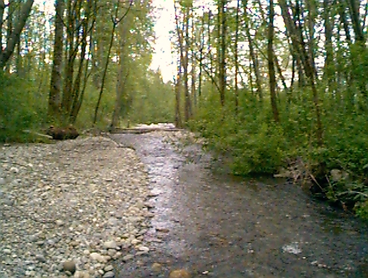
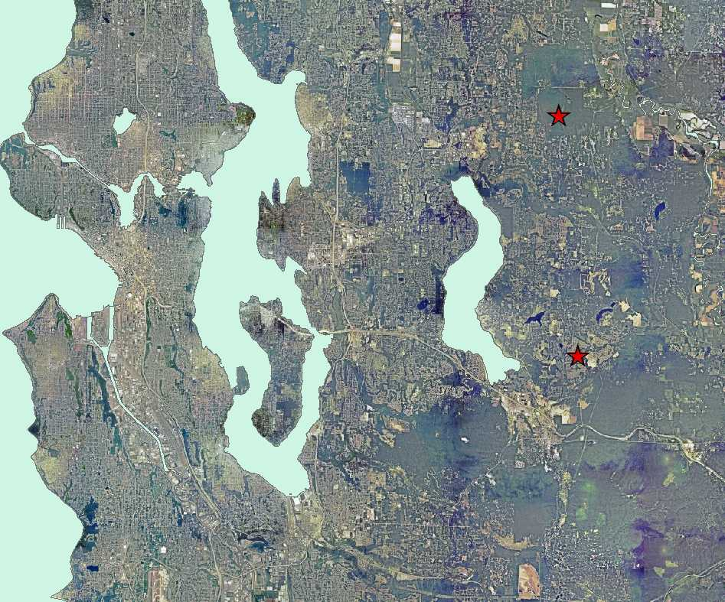
Converting Forest to Developed Cover Can Alter Hydrology
Burges et al. 1998. Hydrological Effects of Land-Use Change in a Zero-Order Catchment. J. Hydrologic Engineer. 3(2):86-97.
Notes:
The effect of conversion of forest to developed land can be demonstrated with observational data.

Slide 5
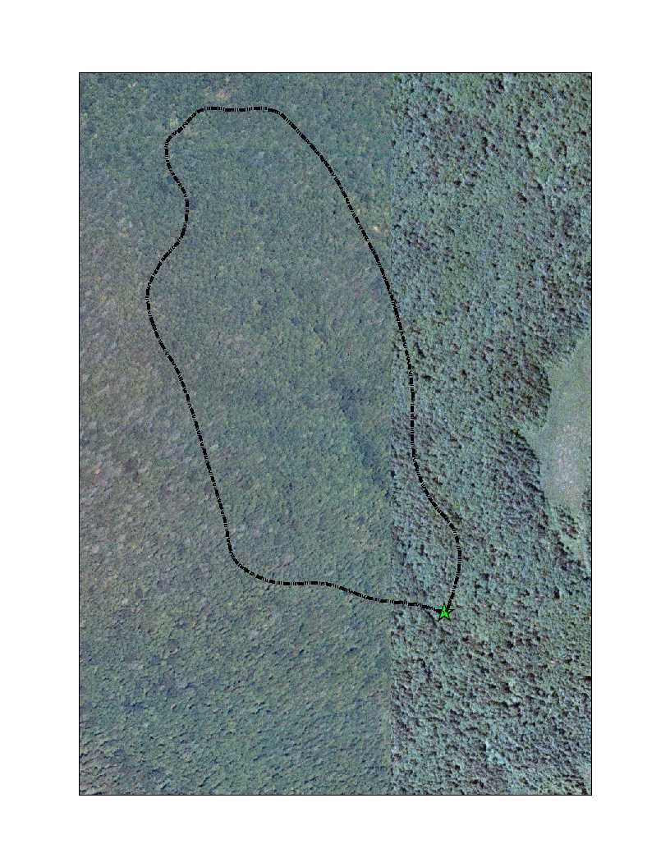
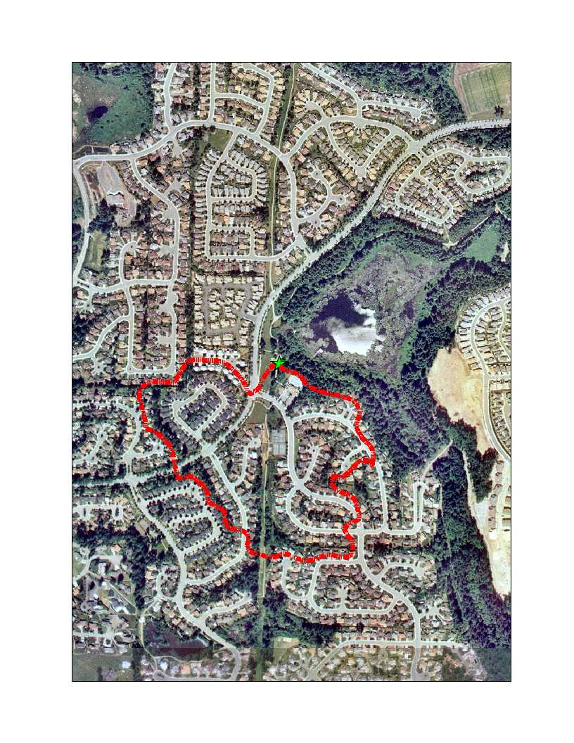
Converting Forest to Developed Cover Can Alter Hydrology
Novelty
Klahanie

Slide 6
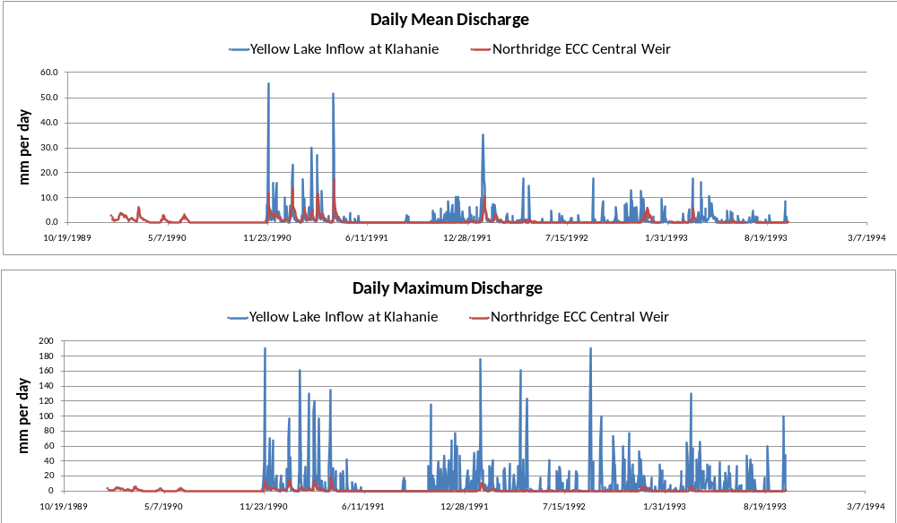
Converting Forest to Developed Cover Can Alter Hydrology
Developed
Undeveloped
Notes:
Normalized by basin area. Daily mean flow and daily instantaneous peak flow. There are more peaks and the magnitude of peaks substantially increased under developed conditions. Note that almost no summer peaks are generated in the forested basin.

Slide 7
Stormwater Management Paradigm
Time Period | Paradigm | Description
Prior to ~1979 | Drainage Efficiency | Convey water downhill as efficiently as possible
1979 – Now | Reduce New Impacts | Reduce harm from new construction with flow control and treatment
Future | Reduce New and Existing Impacts | Capture, infiltrate, detain and treat stormwater everywhere to protect and rehabilitate receiving waters

Slide 8
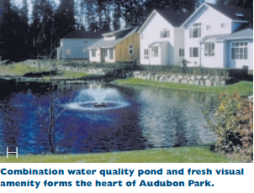
Stormwater Mitigation History
Peak standard – Rational Runoff Formula (1979)
Peak standard – SCS curve-number methodology (1990)
Duration standard – Continuous flow modeling (1998)
  Threshold discharge for bed disturbance
  Point discharge from spatially distributed subsurface runoff
  Aggregate duration matching (pre- and post-development)
  Exemption of rural-zoned development from detention requirements
Booth et al. (2002). Forest cover, impervious-surface area, and the mitigation of stormwater impacts. JAWRA 38(3).
Notes:
Duration standard designed to maintain channel stability but implies a compromise…that there is an average of protection across the County. A much more expensive/intensive approach would be a reach-specific channel stability analysis. Definitely doesn’t protect sand-bedded streams.

Slide 9
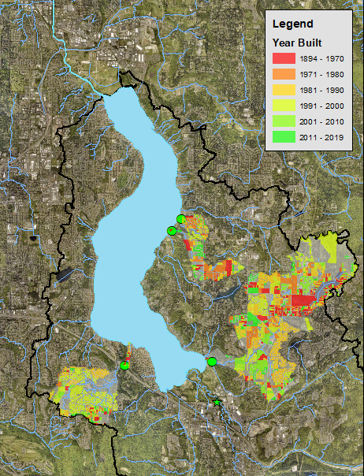
When and where development occurred important
Before ~1990, little or no flow control
Between ~1990-2000, inadequate flow control
After ~2000 modern flow control requirements
And there are limits to stormwater mitigation
  Development threshold exceptions
  Subsurface flow becomes point source
  Runoff volume generally increases
  Substrate variability is not explicitly addressed
Notes:
Point out Lewis and Laughing Jacobs creeks

Slide 10
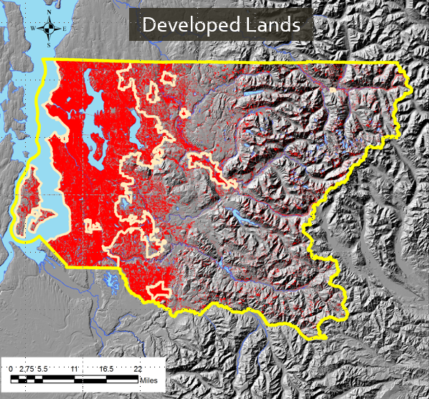
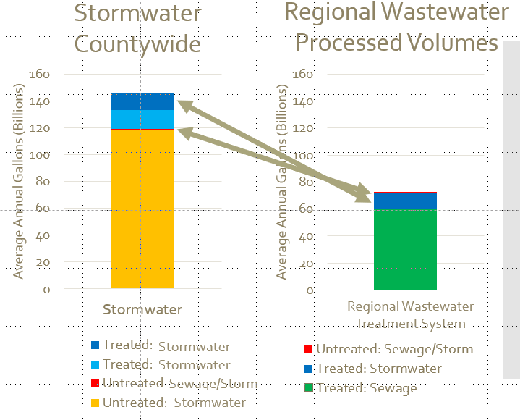
Stormwater is a big deal!
Jeff Burkey. November 28, 2018. Updated Estimate of the Annual Average Volume of Treated and Untreated Stormwater
Runoff from Developed Lands in King County. Technical Memorandum to Josh Baldi, WLR Division Director.

Slide 11
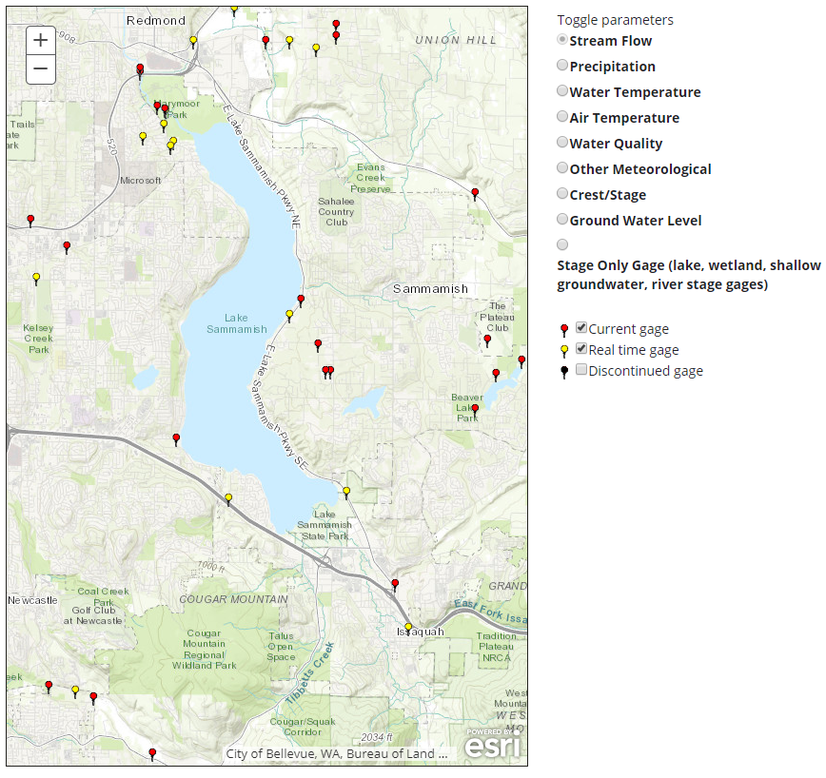
Available data
Zackuse Creek (15i) *
Ebright Creek (15h)
King County gages
USGS gage†
Laughing Jacobs Creek (15c)
Lewis Creek (63a)
* Zackuse gage funded by City of Sammamish
† Partially funded by King County
Issaquah Creek (12121600)†
Notes:
Four active continuous King County stream flow gages. There is also a USGS gage near the mouth of Issaquah Creek. Focus on smaller kokanee creeks.

Slide 12
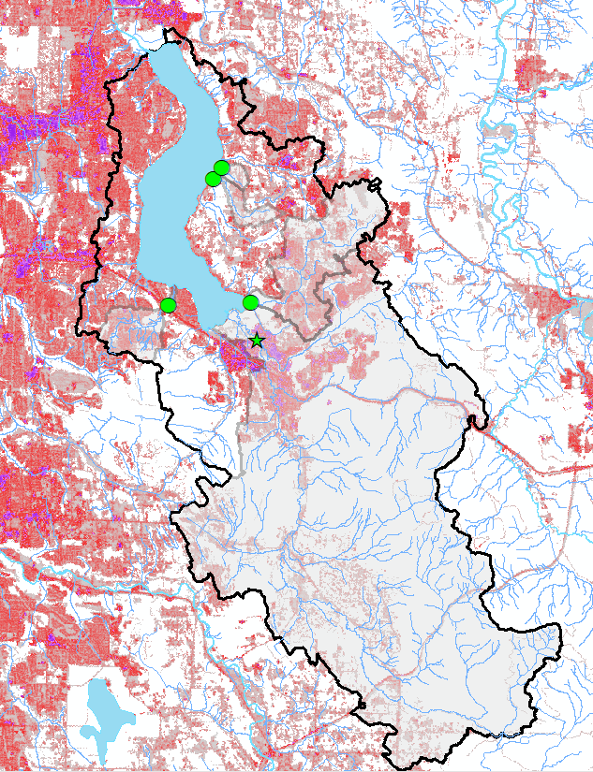
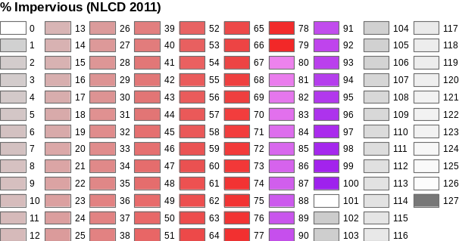
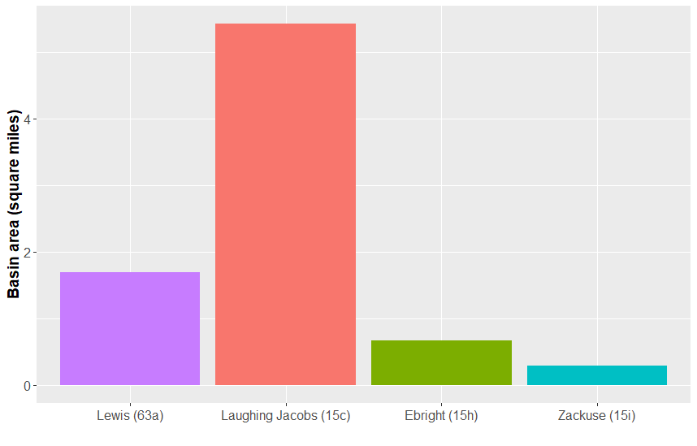
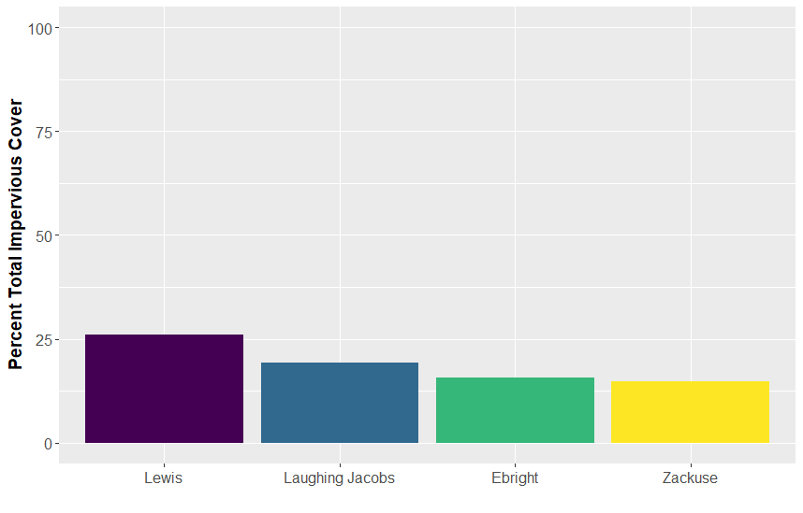
Look at three factors
Basin Area
Annual Precipitation
45-50 inches
Laughing
Jacobs
Ebright
Zackuse
Lewis
Impervious Area

Slide 13
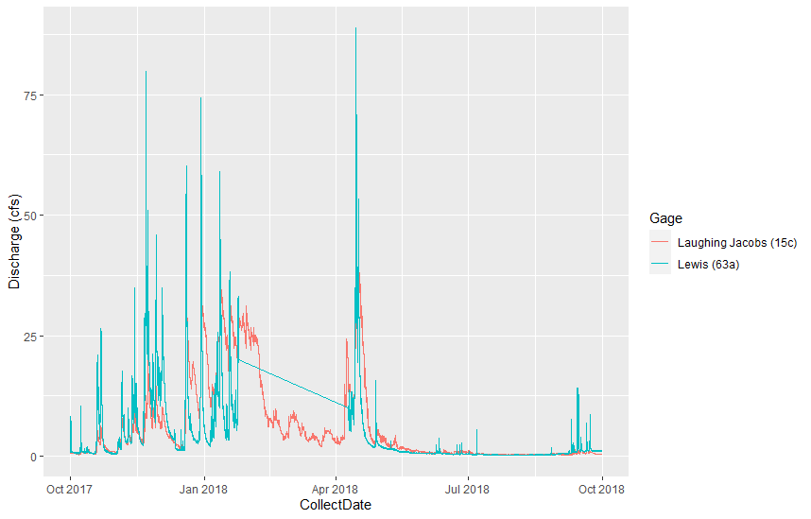
Annual flood frequency analysis
Timing of peaks not always the same across streams
Missing data can make it difficult to be certain that annual peak was recorded
Even more difficult for smaller periods of interest – season or month
Need at least 10+ years
Laughing Jacobs and Lewis Creeks
Water Year 2018

Slide 14
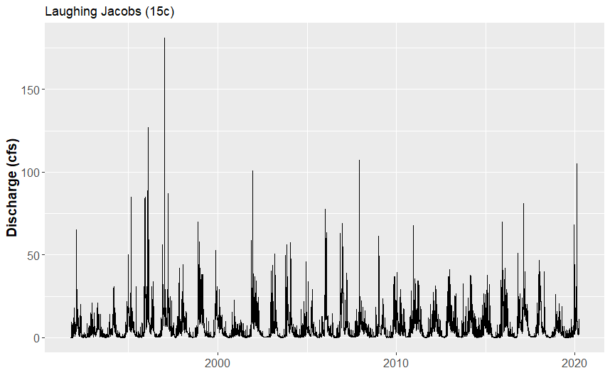
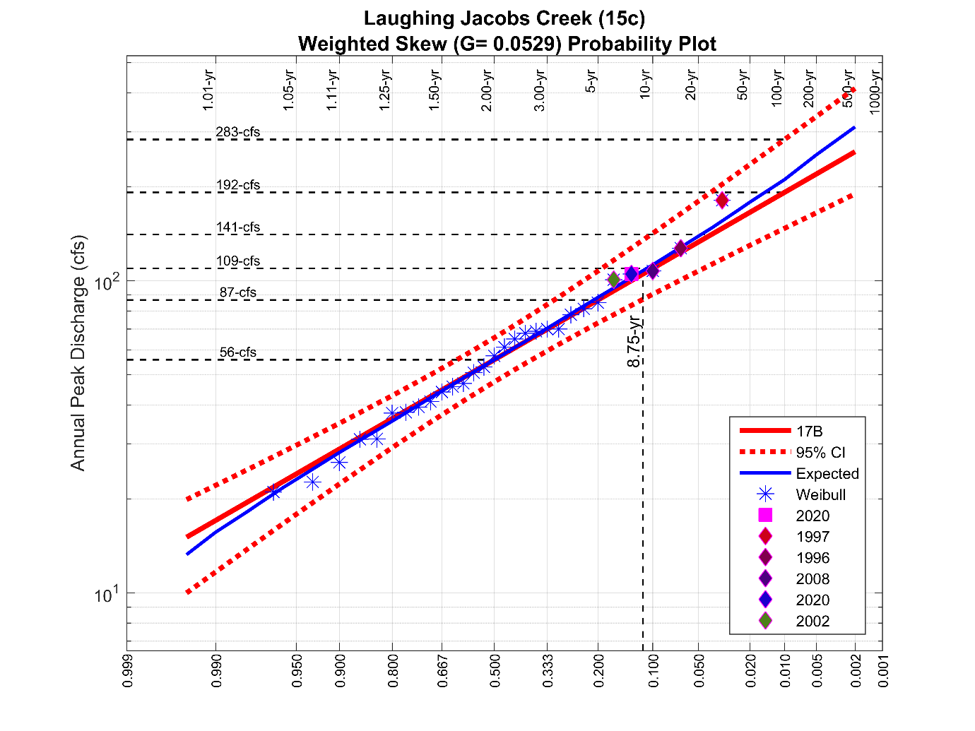
Laughing Jacobs Creek
Annual maximum Q in February 2020
~ 9 year return period (11% annual exceedance prob)
February 2020 peak for Water Year 2020

Slide 15
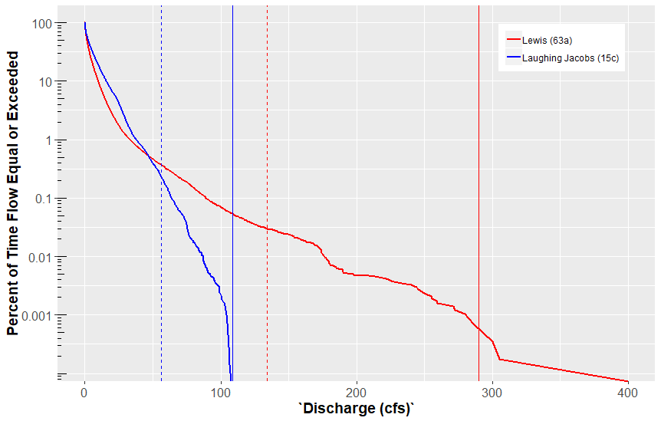
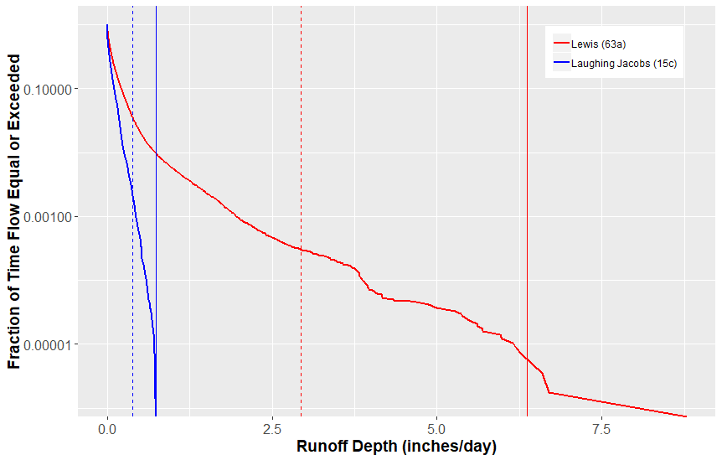
Flow duration curves (Lewis and Laughing Jacobs)
2-yr
Lewis
Laughing Jacobs
Based on 15-minute data collected Oct 1, 1999 to Oct 1, 2019
10-yr
Discharge
Lewis
Laughing Jacobs
Runoff depth
Lewis Creek generates more runoff than Laughing Jacobs even after adjusting for differences in drainage area

Slide 16
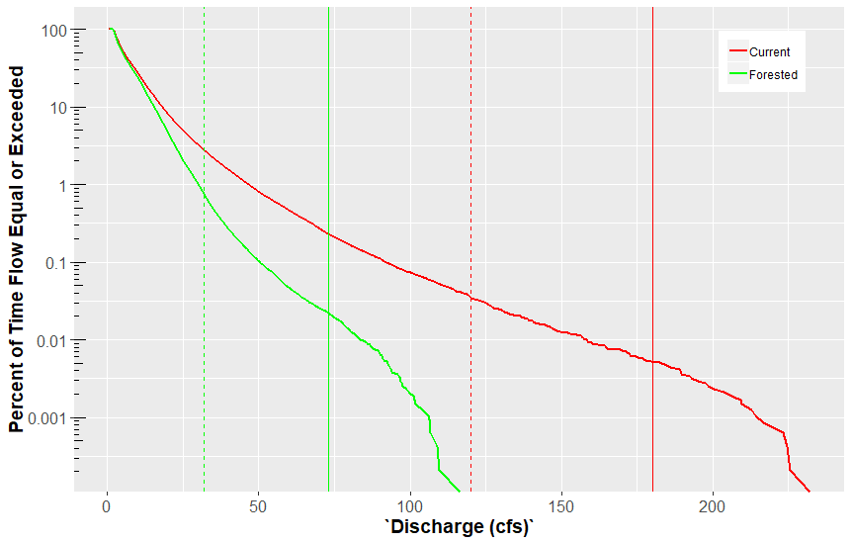
Modeled Flow Duration for Laughing Jacobs
Current (~1990s)
Forested
2-yr
Caution: All models are wrong
Modeled Laughing Jacobs Creek “Current” 2-yr peak of 120 cfs is greater than the 10-yr “Forested” peak of 73 cfs
Forested 10-yr/Current 2-yr = 73/120 = 0.60
10-yr
“Current”
“Forested”
Notes:
Take home: Laughing Jacobs Forested 10-yr/Current 2-yr = 73/120 = 0.60

Slide 17
Recall from Booth and Jackson (1997)….

Slide 18
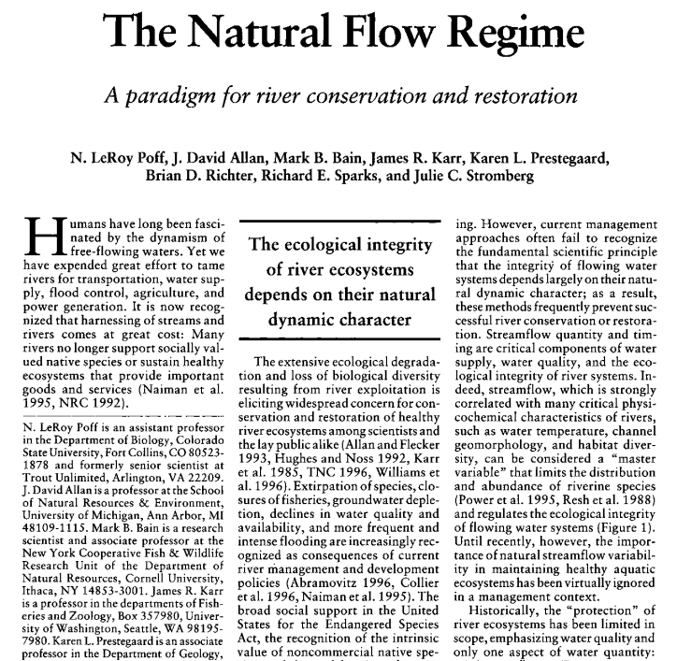
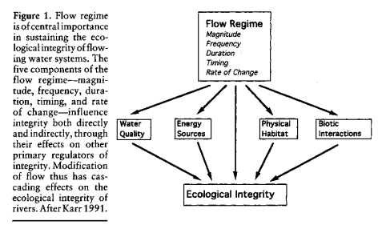
1997
Timing
Duration
Magnitude
Frequency
Rate of Change

Slide 19
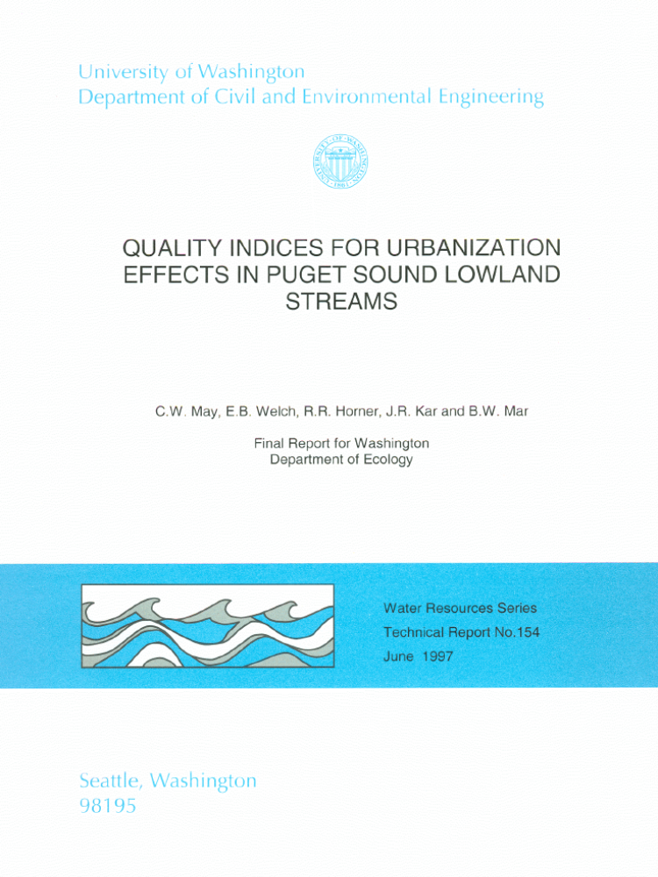
Altering hydrology (among other things) can alter biology
1997
May et al. 1997. Quality Indices for Urbanization Effects in Puget Sound Lowland Streams. University of
Washington, Seattle, WA. Water Resources Series Technical Report No. 154.

Slide 20
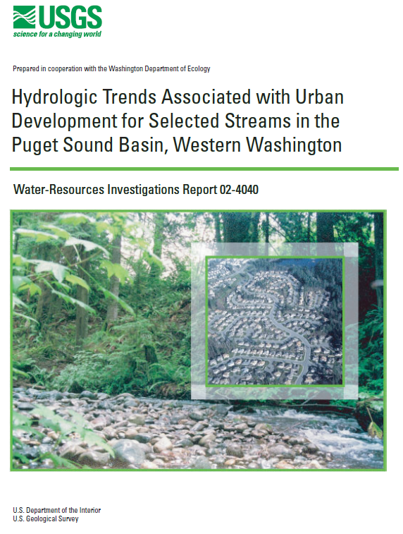


Konrad (2000), Morley (2000), Konrad and Booth (2002)
2000-2002

Slide 21
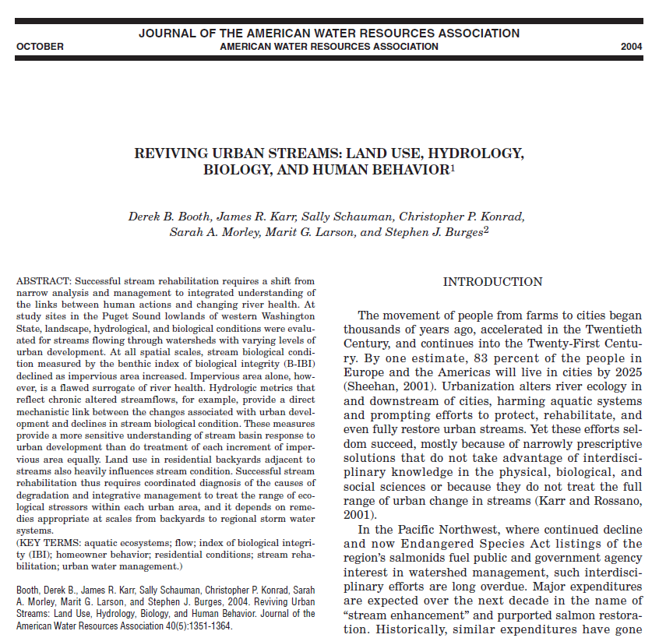
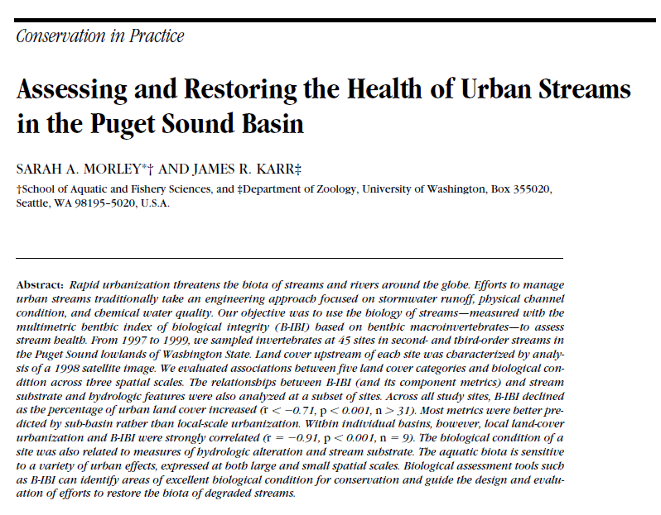
Morley and Karr (2002), Booth et al. (2004)
2002-2004

Slide 22
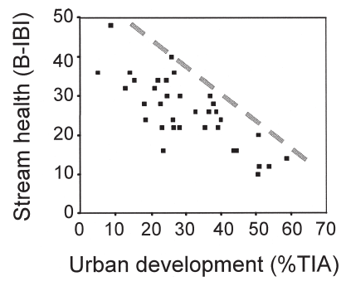
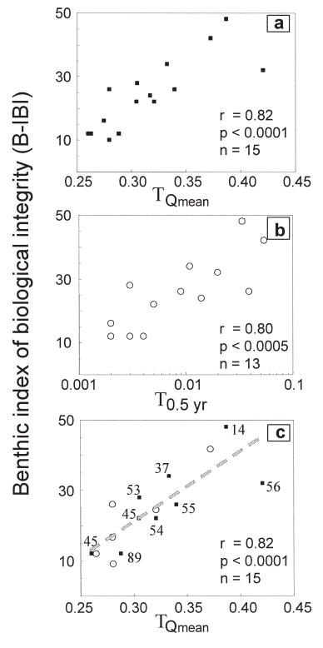
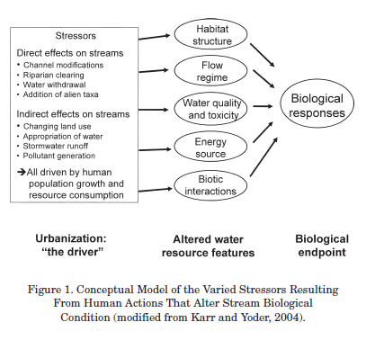
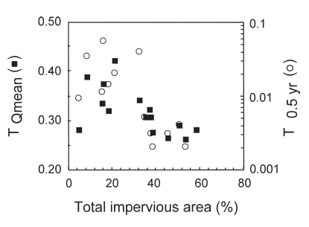
Booth et al. (2004) Reviving urban streams: land use, hydrology, biology, and human behavior

Slide 23
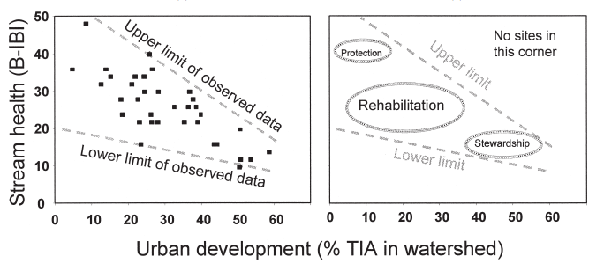
Booth et al. (2004) Reviving urban streams: land use, hydrology, biology, and human behavior

Slide 24
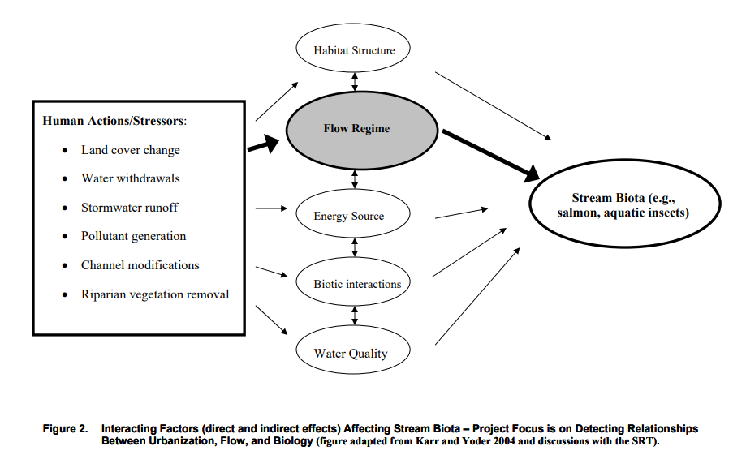
King County Normative Flow Studies
Notes:
At about the same time as

Slide 25
Normative Flow Concept
Can we develop a valid and defensible small stream flow assessment method using Normative Flow concepts for application to flow management issues in King County?
Adapted from King County Normative Flow Studies web page – bullet one
https://www.kingcounty.gov/services/environment/watersheds/general-information/normative-flow-studies/products.aspx

Slide 26
What is “Normative Flow” aka “Natural Flow Regime”
Not an attempt to return the landscape to pre-European conditions
However…
historical conditions give us clues to flow regime that native biota were adapted to

Slide 27
Normative flow principles
Flow is a major determinant of stream habitat, which in turn is a major determinant of biotic composition.
Aquatic species have evolved life history strategies primarily in direct response to natural flow regimes.
Maintenance of natural patterns of longitudinal and lateral stream connectivity is essential to the viability of many aquatic species.
Adapted from: Bunn and Arthington (2002)

Slide 28

Challenges
Direct observations of the pre-disturbance flow regime are generally unavailable.
Co-located hydrological and biological (or chemical) observations are rare.
Few “reference” streams available.
Covariation of land development and natural landscape features.
How to incorporate climate variability?

Slide 29
Requirements
Can be calculated annually
Component metrics chosen to minimize redundancy
Demonstrated trend with time (low interannual variability)
Correlated with land cover metrics
Correlated with biological metrics
Relatively unaffected by basin area/elevation/precipitation totals

Slide 30
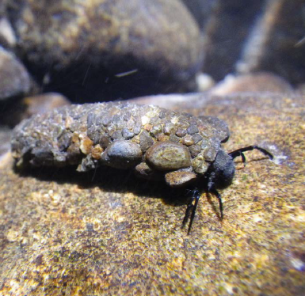
Assumptions
Biological response occurs over multi-year time scales
Biota will respond to “normative flow” restoration (reversibility)
A “Normative” hydrologic index will require the use of models to estimate the historical flow regime

Slide 31
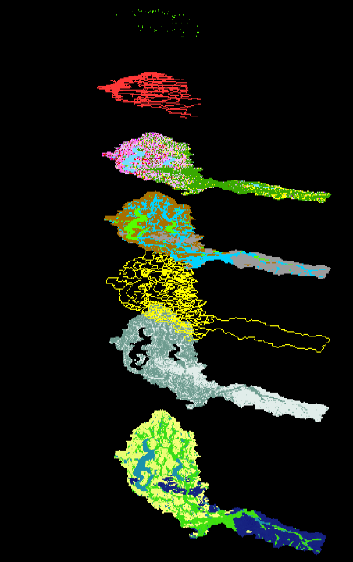
Models
Ability to predict mean annual flow
Ability to predict hydrologic metrics
Account for climate variability
Extrapolate to ungauged locations

Slide 32
Hydrologic Metrics
Magnitude
  7-day average annual minimum flow
Duration
  Low and high flow pulse duration
  Low and high flow pulse range
  Fraction of year mean annual flow exceeded (T_{Qmean})
Frequency
  Flow reversals
  Low and high flow pulse counts
  Fall and rise counts
Timing
  Date of annual daily minimum flow
Rate of Change
  Rise and fall rates
Richards-Baker Flashiness Index
T_{Qmean}

Slide 33
Hydrologic Metric Calculations
High and Low Flow Pulses
TQmean
R-B Index

Slide 34
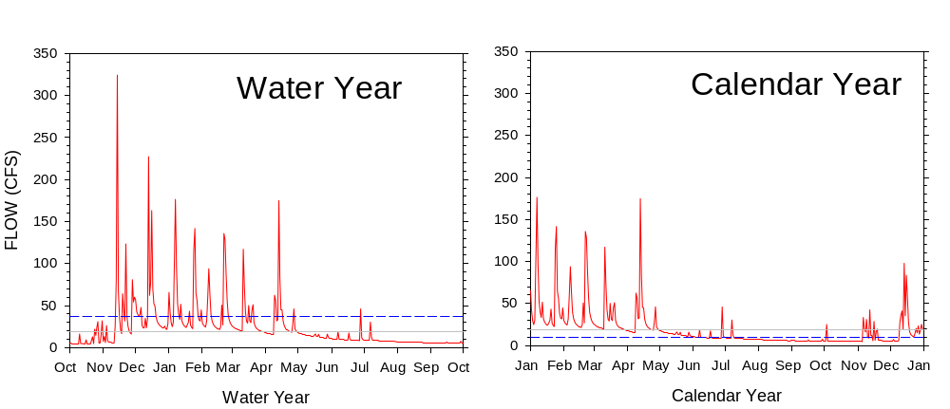
2 x mean flow
High Flow Pulses
Low Flow Pulses
Long-term mean flow
0.5 x mean flow

Slide 35
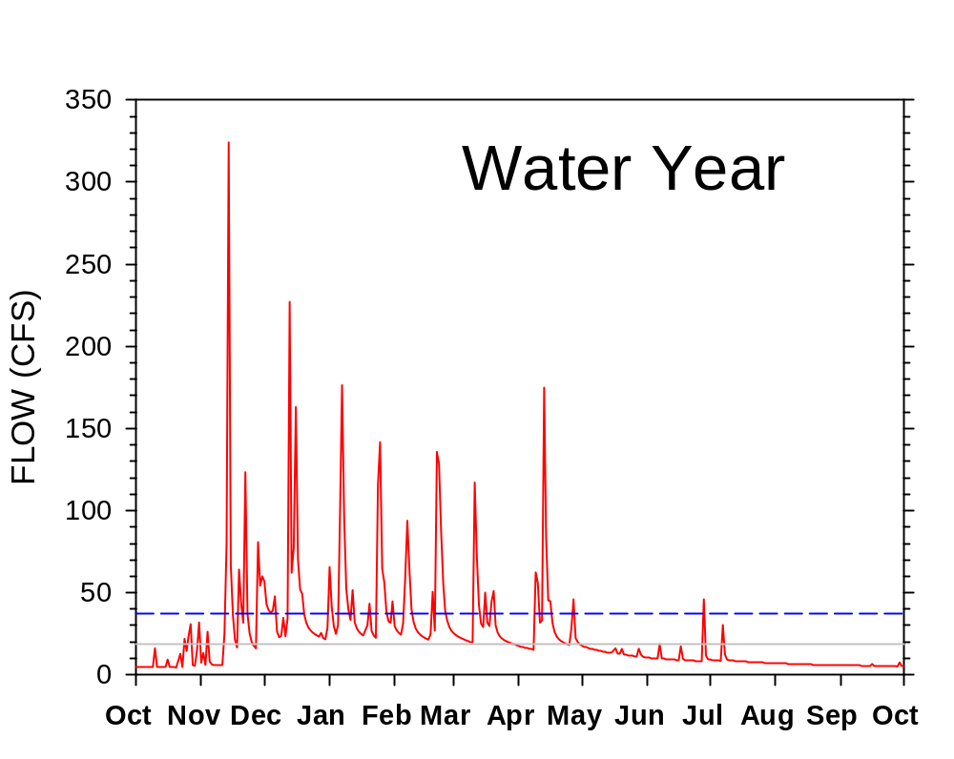
High Flow Pulses – Current Conditions
2 x mean flow
21 Pulses

Slide 36
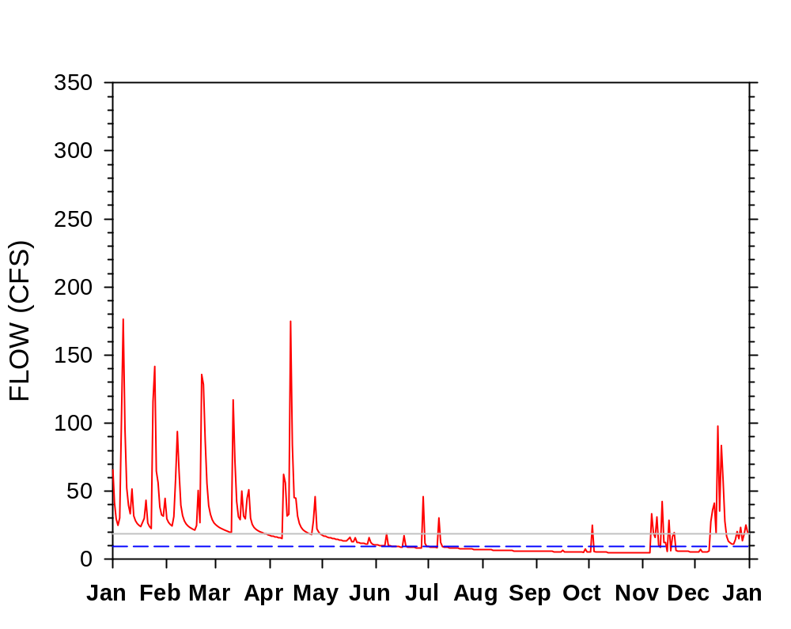
Low Flow Pulses – Current Condition
0.5 x mean flow
6 Pulses

Slide 37
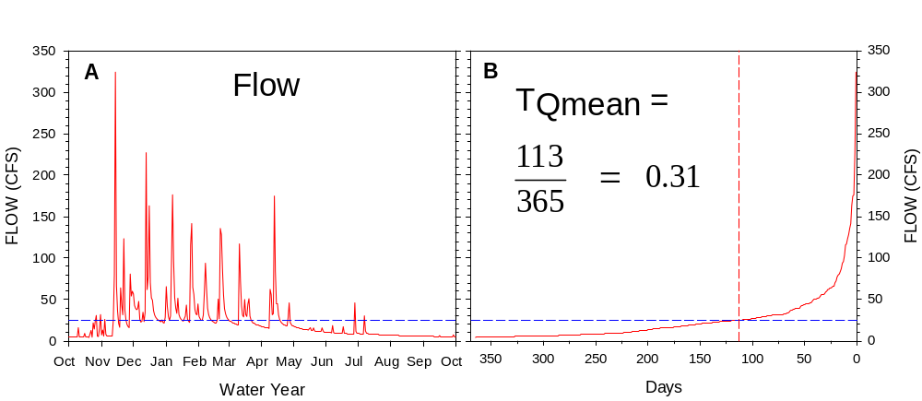
Hydrologic Metric Calculations
Number of days mean annual flow is exceeded
High and Low Flow Pulses
T_{Qmean}
R-B Index
Rise and Fall Rate
Rise and Fall Count
Mean annual flow
FLOW
WATER YEAR
DAYS
Notes:
TQmean is lower in urban streams due to increased storm flow volume, rapid recession rates, and lower wet-season base flow.

Slide 38

Hydrologic Metric Calculations
High and Low Flow Pulses
T_{Qmean}
Richards-Baker Index
Rise and Fall Rate
Rise and Fall Count

Slide 39
Benthic Index of Biological Integrity
Taxa Richness and composition
  Total number of taxa
  Number of Ephemeroptera (mayfly) taxa
  Number of Plecoptera (stonefly) taxa
  Number of Trichoptera (caddis fly) taxa
  Number of long-lived taxa
Tolerance
  Number of intolerant taxa
  Percent of individuals in tolerant taxa
Feeding Ecology
  Percent of individuals that are predators
  Number of clinger taxa
Population attributes
  Percent dominance (top 3 taxa)
Response to Human Dist.
  ↓
  ↓
  ↓
  ↓
  ↓
  ↓
  ↑
  ↓
  ↓
  ↑

Slide 40
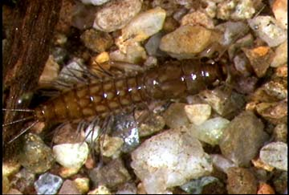
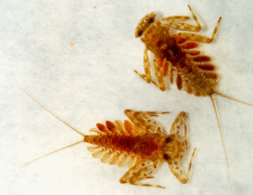
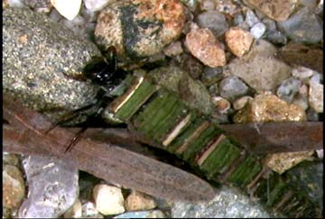
Ephemeroptera (mayflies)
Plecoptera (stone flies)
Tricoptera (caddis flies)
EPT Taxa

Slide 41
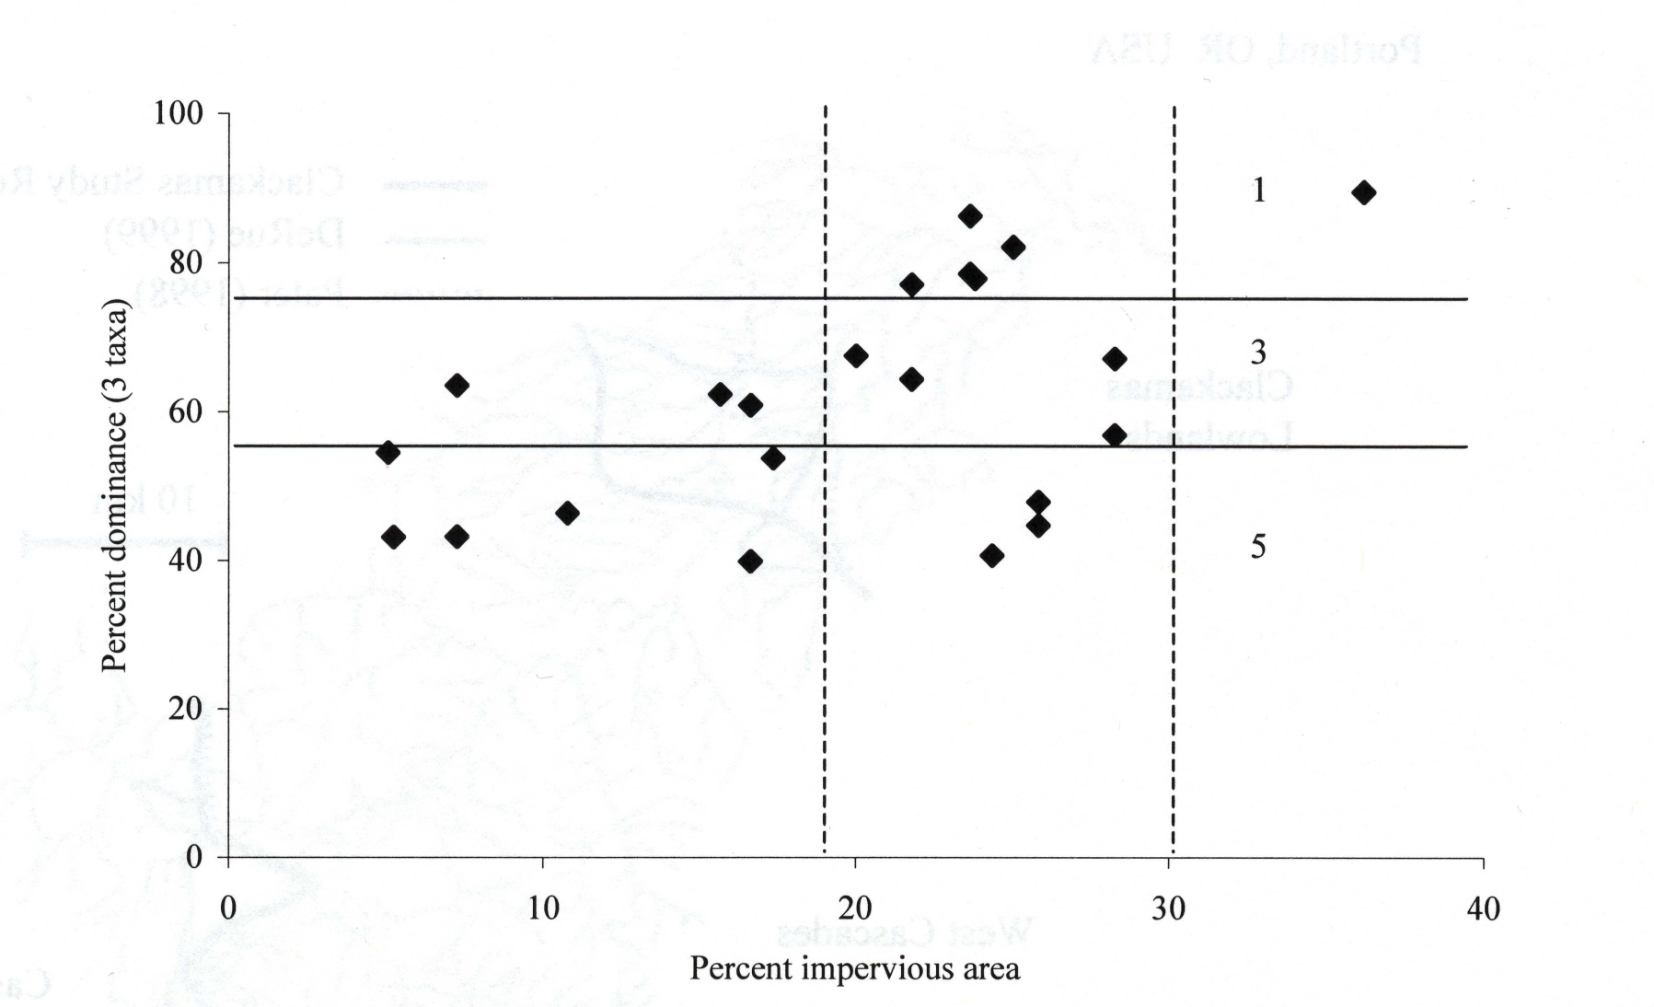
B-IBI “Calibration”
% Dominance
1
3
5
% TIA

Slide 42
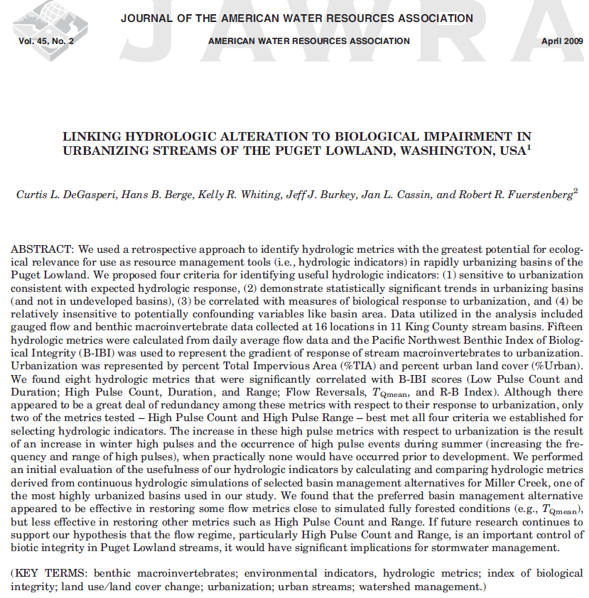
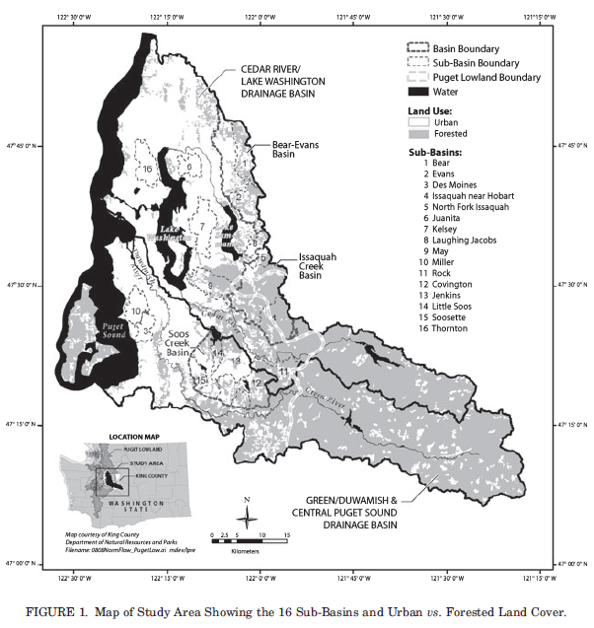
DeGasperi et al. (2009) Linking hydrologic alteration to biological impairment in urbanizing streams of the Puget Lowlands
2009

Slide 43
Eight Candidate Metrics
High Pulse Count
High Pulse Range
High Pulse Duration
Low Pulse Count
Low Pulse Duration
TQmean
R-B Index
Flow Reversals

Slide 44
Hydrologic Metrics Highly Correlated With Each Other (and %imperviousness)

Slide 45
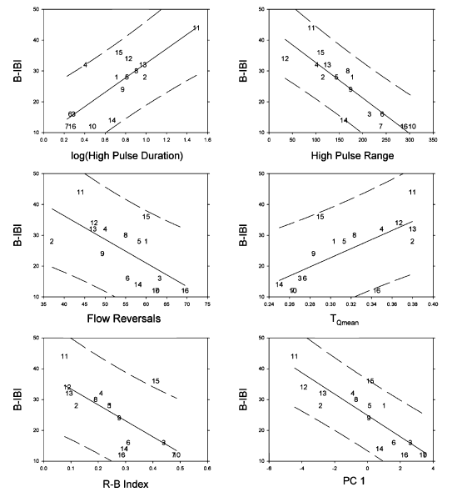
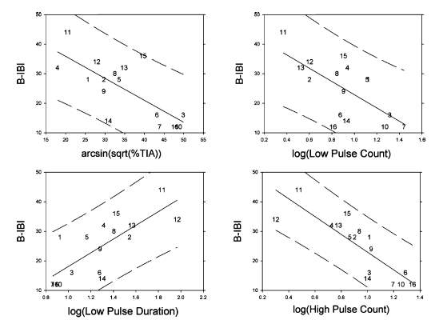
Hydrologic metrics correlated with B-IBI (n = 16)
TQmean (47%)
HIGH PULSE COUNT (71%)
R-B Index (49%)

Slide 46

CAUTION!
Correlation does not equal causation.

Slide 47

Hydrologic Metrics Respond to Basin Urbanization over Time
USGS Mercer Creek Bellevue, WA
HPC
TQmean
R-B Index

Slide 48


Miller Creek Basin Plan Case Study

Slide 49


Degree of Hydrologic Alteration Range of variability approach
T_{Qmean}
Fully-Forested
Current Conditions
1949-2002
1949-2002
25th and 75th Percentiles

Slide 50

High
Medium
Low
TQmean
Degree of Hydrologic Alteration

Slide 51


WRIA 8 Status & Trends
Boosted Regression Tree Models
HPD
HPC
RBI

Slide 52


WRIA 8 Status & Trends n = 28
North Creek
Venema Creek

Slide 53



City of Bainbridge Island (2015)
%Development
%Forest
HPC
RBI
B-IBI 0-100
TQmean

Slide 54


Necessary, but not necessarily sufficient
Reference
Organic pollution index
Fine sediment index
Metals tolerance index

Slide 55

Necessary, but not necessarily sufficient
ceiling
Above HPC of ~12
almost guaranteed
to have BIBI less than
35 (10-50 scale)
Below HPC of ~12
B-IBI scores can range from 10 to more than 35 (10-50 scale)

Slide 56

SAM 2015 small streams study
Most important stressors for B-IBI scores…
Stream Health Category | Significant Stressors
Land cover | Watershed Canopy Cover Riparian Canopy Cover Percent Urban Development
Water | Total Nitrogen Total Phosphorus
Sediment | Total Zinc Substrate Embeddedness Substrate Particle Diameter

Slide 57


Slide 58
Stormwater Management Applications
Juanita Creek Stormwater Retrofit
WRIA 9 Stormwater Retrofit Study
Bear Creek Watershed Management Study

Slide 59

What Are Stormwater Retrofits
Construction projects to control stormwater
Locations that have previously been developed
Sited where existing stormwater controls are inadequate
Not part of redevelopment

Slide 60

Why are Retrofits Important?
Most developed areas have no or inadequate controls
Large storm flows erode streams
Untreated stormwater harms fish
Retrofits improve flow and water quality

Slide 61







Stormwater Retrofit Examples
Check Dams
Bioswales
Cisterns
Ponds
Pervious Pavement
Green Roofs
Rain Gardens

Slide 62

Juanita Stormwater Retrofit Study

Slide 63

Juanita Creek Stormwater Retrofit

Slide 64

WRIA 9 Stormwater Retrofit Study
Notes:
Discuss project goals and demostration of SUSTAIN application

Slide 65


Project Area
WRIA 9 except
  Headwaters above Howard Hanson Dam (forested)
  City of Seattle (combined system)
  Vashon Island
Focus on streams

Slide 66

SUSTAIN: System for Urban Stormwater Treatment and Analysis INtegration
U.S. EPA model developed to assist stormwater managers in selecting cost-effective stormwater BMPs to meet watershed goals.
Model Inputs:
BMP Design and Cost Assumptions
Flow or water quality goals
Source: EPA

Slide 67

What is SUSTAIN?
An ArcGIS-based framework designed to support evaluation and decision making:
  How effective are green and/or gray treatment BMPs in reducing runoff and pollutant loadings?
  What are the most cost-effective BMP options to meet specified water quantity and quality objectives?
http://www2.epa.gov/water-research/system-urban-stormwater-treatment-and-analysis-integration-sustain
Notes:
A bit more on what SUSTAIN is for….emphasizing cost-effective approach for meeting specified water quantity and/or water quality targets
Applications across the U.S.

Slide 68

SUSTAIN Applications
Los Angeles County, CA
Upper North Branch Oak Creek, MI
Little Rocky Run, VA
Kansas City, MO
Louisville, KY
http://www.epa.gov/nrmrl/wswrd/wq/models/sustain/#Downloads
Notes:
SUSTAIN has been applied in stormwater and CSO control management studies at a number of locations throughout the US. I can point anyone that is interested to these documents if you provide me your contact information during the break or after the workshop.
Although SUSTAIN has been applied successfully in a number of studies, we admittedly have had some difficulty working through

Slide 69
Data Needs
Land Use/Land Cover map in GIS
Watershed model
  Internal model in SUSTAIN
  External model (Examples: HSPF, SWMM)
BMP types, design configurations, costs
Instream targets
Notes:
Overview of data needs, emphasizing that we are using the External Model option in SUSTAIN…HSPF watershed model…and that we have most of what we need at this point:
2007 Land Use/Land Cover from University of Washington Urban Ecology Research Laboratory (UERL)
Stream network and HSPF watershed models
Instream targets
But we still need inputs on BMP types, design configurations, and costs
Today we are looking for input on BMP types
Design configurations and costs will be the work of the project technical team

Slide 70

Notes:
I want to say something about scale because the scale of the application (or really the project goal) determines which approach is feasible within the time and resource constraints of this project
We are interested in coming up with stormwater retrofit cost estimates for most of WRIA 9 below Howard Hanson Dam and extrapolating costs to the Puget Sound basin. A site specific analysis that explicitly simulates BMPs at every household, road, or parking lot is not feasible. SUSTAIN offers what is called an Aggregate BMP approach that allows the use of scalable BMPs on a reasonable sub-basin scale.

Slide 71
Two Optimization Options
Scatter Search – minimize cost to achieve multiple objectives (e.g., flow and water quality)
NSGA-II – Non-dominated Sorting Genetic Algorithm II to develop a cost-effectiveness curve based on a single objective

Slide 72
Cost-Effectiveness Optimization
Effectiveness (%Reduction)
Cost in Millions of Dollars

Slide 73
Cost-Effectiveness Optimization
Cost in Millions of Dollars
Effectiveness (%Reduction)

Slide 74


Slide 75


Residential On-site Detention Facilities
50 gallon rain barrel
$220 unit cost including construction
$ 85.40 per yr I&E
O&M assumed negligible
Total Present Value unit cost =
$1,533
~3,000 gallon cistern
$1,600 unit cost including construction
$ 85.40 per yr I&E
O&M assumed negligible
Total Present Value unit cost =
$2,913
30-yr lifecycle cost assuming 5% discount rate

Slide 76



Bioretention Facilities
1 Unit is 100 ft²
$20/ft² Design, permitting, and construction
Rain Garden
$ 1.10/ft²-yr O&M
$213.50 per yr I&E
TPV cost = $69.73/ft²
Roadside Bioretention
$ 1.10/ft²-yr O&M
$170 per yr I&E
TPV cost = $63.04/ft²
30-yr lifecycle cost assuming 5% discount rate

Slide 77



Porous Parking Areas
1 Unit is 100 ft²
$ 20/ft² design, permitting, and
construction
$ 0.02/ft² O&M
$427.00 per yr I&E
TPV = $85.95/ft²
30-yr lifecycle cost assuming 5% discount rate

Slide 78


Detention Pond
1 Unit is ~13,000 ft³
$ 3.43/ft³ construction cost
$ 1.20/ft³ design and permitting
$ 0.01/ft³ O&M
TPV Cost = $ 25.81/ft²
or $ 4.78/ft³
Land cost = $18.25 ft²
30-yr lifecycle cost assuming 5% discount rate

Slide 79

Modeling Approach
Study area: 278 mi², 446 catchments
Model 135 hypothetical 100-acre catchments representing combinations of:
  5 generic land uses
  3 soil types
  2 slopes
  3 precipitation zones
  2 land costs
Notes:
This is a modeling project.
We modeled different factors that influence the size and type of stormwater retrofits, such as…
Scaled the results to the project area and extrapolated to puget sound

Slide 80

SUSTAIN Optimization Target:
Reduce Stream Flashiness
High Pulse Count (HPC): Number of times mean daily flows ≥
high-flow threshold set at 2 X long-term mean daily flow rate
Notes:
Hydrologic indicator that can provide link to biological health

Slide 81

Indicators,Targets and Goals
Horner, R.R. 2013. Development of a Stormwater Retrofit Plan for Water Resources Inventory Area 9: Flow and Water Quality Indicators and Targets. King County Water and Land Resources Division, Seattle, Washington.

Slide 82
SUSTAIN
Output
HPC
Each point represents
a possible BMP strategy
B-IBI

Slide 83
Modeled Infrastructure Needs
Average of 2.5 inches of storage needed throughout the watershed to improve stream flow and water quality to fully forested conditions
Big range based on amount of impervious area
  Up to 4 inches in urban areas
  As little as 0.1 inches in rural areas
Hydrology has potential to support good to excellent BIBI scores
Notes:
Storage is amount of runoff needed to be captured by stormwater facilities to meet optimization target
More storage needed in urban areas, less in rural areas
B-IBI

Slide 84
Annual Public Costs: WRIA 9 Project Area
 | 30-year | 100-year
Annual Capital Costs | $210M | $46M
Annual Operating Costs* | $650M | $540M
*Operating costs include O&M and I&E costs. Value reflects annual operating costs after all necessary facilities are built.

Slide 85
Annual Public Costs: Puget Sound Basin
 | 30-year | 100-year
Annual Capital Costs | $4.3B | $650M
Annual Operating Costs* | $13B | $11B
*Operating costs include O&M and I&E costs. Value reflects annual operating costs after all necessary facilities are built.

Slide 86


https://www.kingcounty.gov/services/environment/watersheds/sammamish/bear-creek/bear-creek-stormwater-plan.aspx

Slide 87

Bear Creek Watershed Management Study

Slide 88

Bear Creek Watershed Management Study

Slide 89

Current trends – King County – 46 Stations
2000-2020 with at least 15 years of data
Fraction of sites with trend slope less than or equal to
slope

Slide 90

Current hydrologic trends – King County – 46 Stations
2000-2020
McBride, G.M. 2019. Has water quality improved or been maintained? A quantitative assessment procedure. J. Env. Qual. Doe:10.2134/jeq2018.03.0101.
Notes:
Bayesian Credible Intervals on slopes to determine the probability that the slope is not zero

Slide 91


USGS Mercer Creek, Bellevue, WA (12120000 )
Kelsey Creek (08EAS2272)
1937
1996

Slide 92

USGS Mercer Creek, Bellevue, WA (12120000 )
1937
1996

Slide 93

USGS Mercer Creek, Bellevue, WA (12120000 )
Kelsey Creek (08EAS2272)
1937
B-IBI 0-100 Score
1996
2005
2010
2015
2020

Slide 94

Current B-IBI trends – King County
119 Stations 2000-2020 with at least 15 years of data
Fraction of sites with trend slope less than or equal to
slope

Slide 95

Current B-IBI trends – King County – 119 Stations
2000-2020
McBride, G.M. 2019. Has water quality improved or been maintained? A quantitative assessment procedure. J. Env. Qual. Doe:10.2134/jeq2018.03.0101.
Notes:
Bayesian Credible Intervals on slopes to determine the probability that the slope is not zero

Slide 96




Southern California leading the way…

Slide 97


Some other interesting efforts…

Slide 98

King County Organization
Department of Natural Resources & Parks
Water and Land Resources Division

Slide 99
Water and Land Resources Division
Rural and Regional Services
Environmental Laboratory
Rivers and Floodplain Management
Science and Technical Support
Stormwater Services

Slide 100

Science and Technical Support Section
Me

Slide 101

Questions?
Swan Creek, Tacoma, Washington

Slide 102



Thank you.
Curtis DeGasperi, Lead Hydrologist
curtis.degasperi@kingcounty.gov; (206) 477-4677
Water and Land Resources Division
King County Department of Natural Resources and Parks
Notes:
Questions?

Slide 103



Slide 104



Booth et al. 2002 (JAWRA)
Burges et al. 1998 (JHydEng)

