Slide 1
Spring fever revisited. Relationships among Lake Sammamish thermal stratification, anoxia, and phosphorus
Washington State Lake Protection Association
33rd Annual Conference (Virtual)
Curtis DeGasperi, King County Water and Land Resources Division, Seattle, Washington

Slide 2
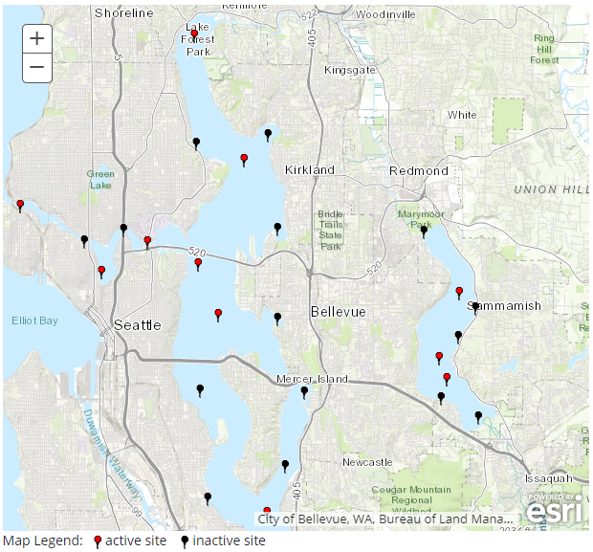
Lake Sammamish
Relatively large and deep lake
  Surface area 19.8 km² ⁽~4,900 acres) Maximum depth 32 m (105 ft)
Note: Lake has recovered from eutrophication following wastewater diversion in the 1960s (Welch et al. 2019).
Welch, E.B. et al. 2019. Stability of Lake Sammamish phosphorus despite land use changes. Lake and Reservoir Management 35:167-180.
Notes:
Difference in relative amount of total load diverted (~3/4 Washington, ~1/3 Sammamish – Issaquah 2º WWTP and milk processing plant). Sediment feedback. Difference in bottom water oxygen conditions related to difference in epi:hyo volume ratio.

Slide 3
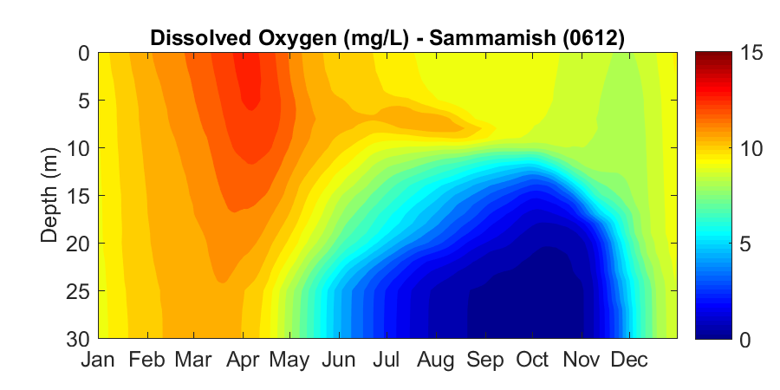
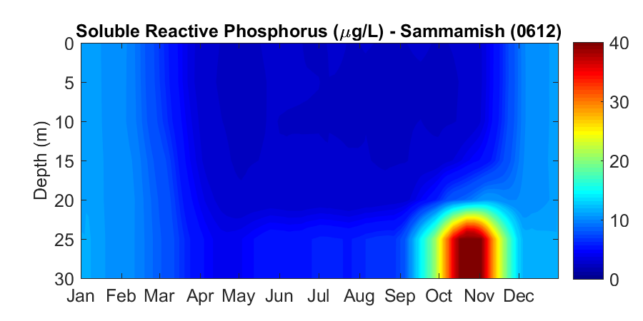
Oxygen and phosphorus
Hypolimnion becomes anoxic in summer
As bottom-water oxygen declines, phosphorus levels increase
Note: Summer hypoxia likely a natural phenomenon (Welch 1977).
Welch, E.B. 1977. Nutrient diversion: Resulting lake trophic state and phosphorus dynamics. U.S. Environmental Protection Agency, Corvallis, Oregon. EPA-600/3-77-003.
Notes:
Observations in August 1913, found lake bottom waters anaerobic….observations of sediment diatoms and chironomids indicate mesotrophy over the last ~150 years. Apparent stability of trophic state attributed to Fe-redox control of phosphorus release and sedimentation. Also wastewater input was to Issaquah Creek that entered the metalimnion during summer.

Slide 4
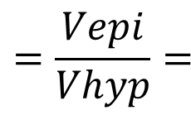
Interesting aside!
Lake Washington
Lake Sammamish
10 meters
Volume_{epi}
Volume_{epi}
$$=\frac{Vepi}{Vhyp}=$$
0.44
1.2
Volume_{hyp}
Volume_{hyp}
Similar P loading and productivity as Lake Washington
However, Lake Sammamish has a smaller hypolimnetic volume relative to epilimnetic volume compared to Lake Washington
Result is summer anoxia in Lake Sammamish, but not in Lake Washington
Vertical exaggeration
~100x
Notes:
Per Welch (1977) ratio of epilimnion to hypolimnion volume is 0.99 assuming 15 m surface mixed layer. I’ll assume 10 m euphotic zone so get 1.2 vs. 0.44 for Lake Washington. Lake Washington maximum depth is 65 meters or 214 feet.

Slide 5
Lake Washington
Lake Sammamish
10 meters
Volume_{epi}
Volume_{epi}
$$=\frac{Vepi}{Vhyp}=$$
0.44
1.2
Volume_{hyp}
Volume_{hyp}
Vertical exaggeration
~100x
Notes:
Per Welch (1977) ratio of epilimnion to hypolimnion volume is 0.99 assuming 15 m surface mixed layer. I’ll assume 10 m euphotic zone so get 1.2 vs. 0.44 for Lake Washington. Lake Washington maximum depth is 65 meters or 214 feet.

Slide 6
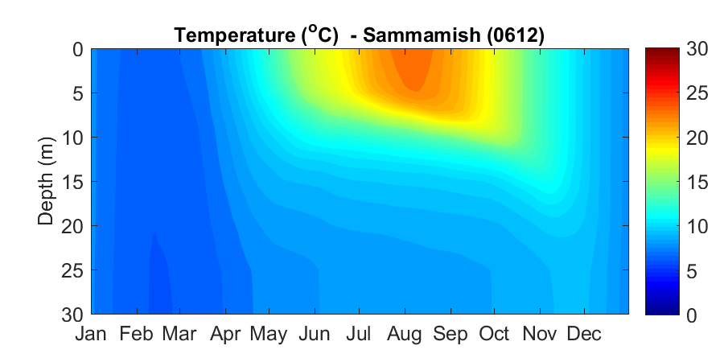
Temperature
Decline in hypolimnetic oxygen closely linked to the onset and timing of thermal stratification

Slide 7
Tala Woodward’s thesis
Is there a relationship between the timing of spring stratification and subsequent summer hypolimnetic oxygen and phosphorus concentrations?
Tested using a 20-year dataset (1993-2012)
Answer?
  Yes! At least in Lake Sammamish, but not in Lake Washington
Woodward, N.E. 2014. Spring Fever? Climate Change and Water Quality in Our Local Lakes. M.S. thesis. University of Washington. Seattle, Washington. 44 p.

Slide 8
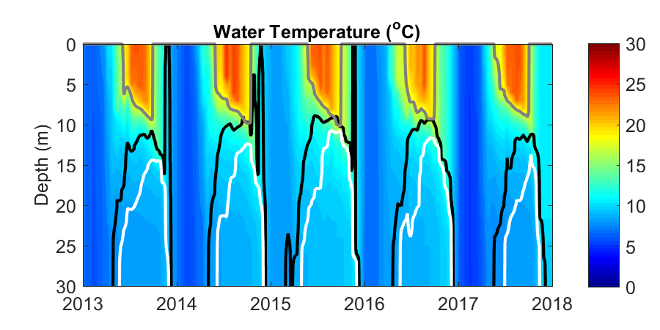
We now have another 7 years of data and…
The snow drought of 2014-2015 happened!
Thermal stratification was earlier, and the duration and extent of anoxia was greater in 2015 than any other year since 1993
Black line - 8 mg DO/L
White line - 4 mg DO/L

Slide 9
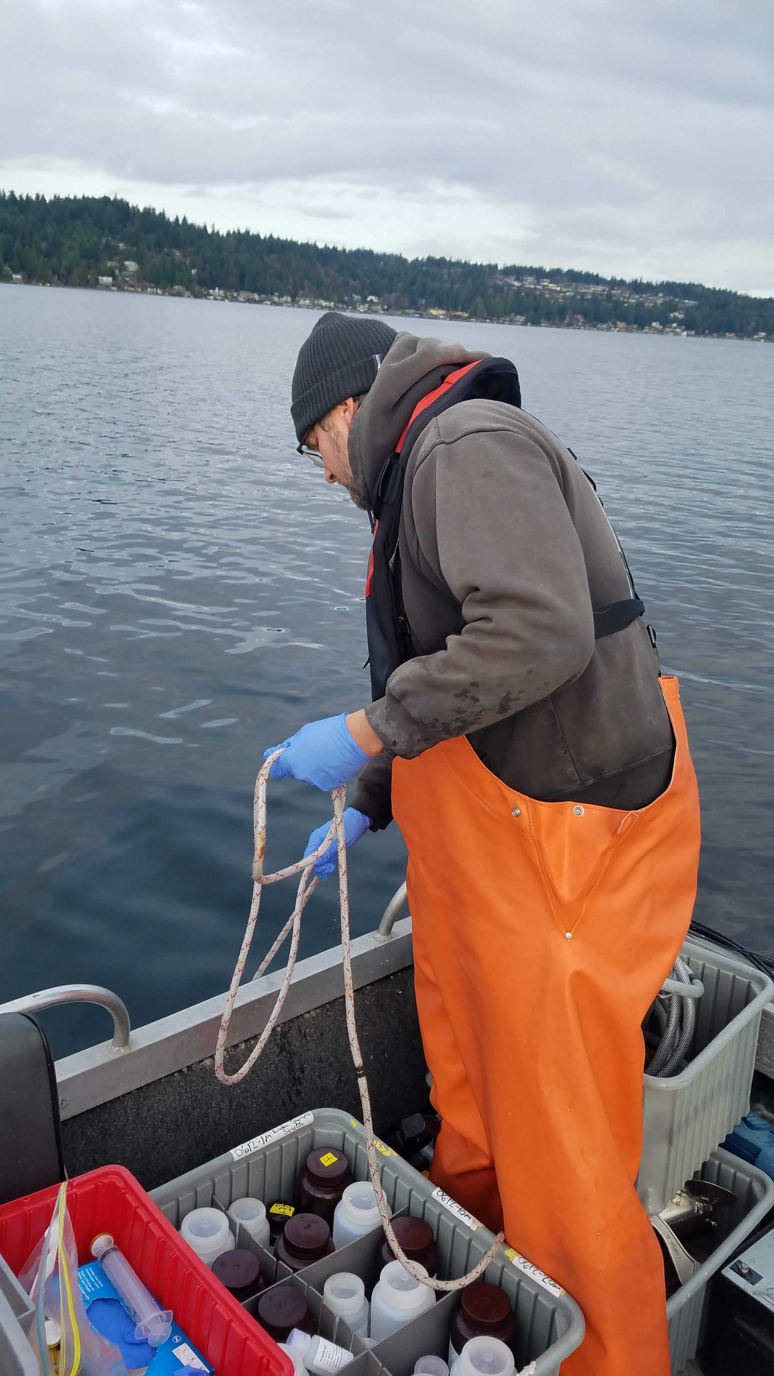
Data analysis based on routine profiling data
Timing of stratification onset and duration
  Based on Schmidt Stability threshold (50 J m⁻²)
Timing of the onset and duration of hypolimnetic anoxia
  Based on threshold of mean hypolimnetic DO <2 mg/L
Summer maximum hypolimnetic total phosphorus
  Based on maximum hypolimnetic average observed June through October

Slide 10
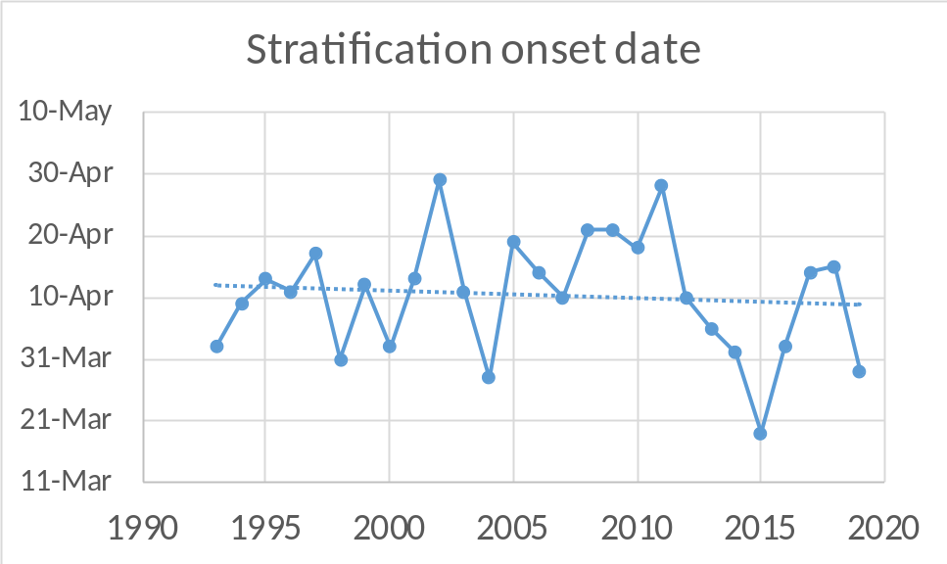
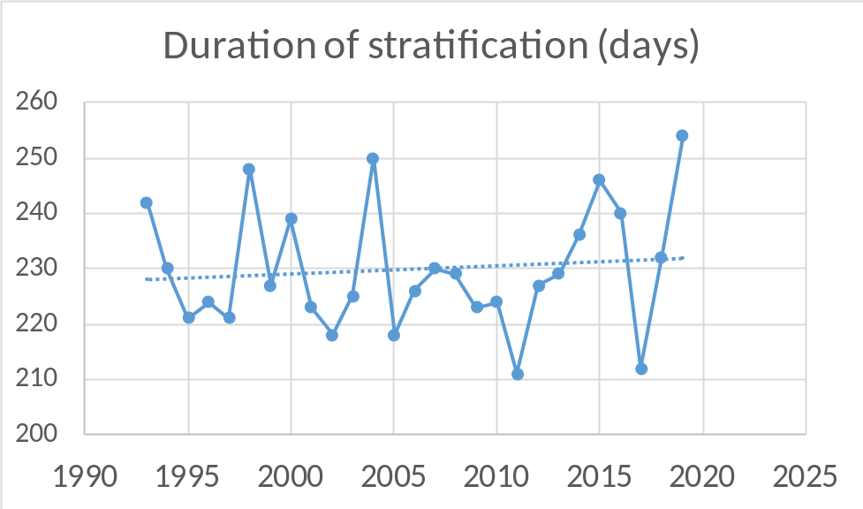
Trends in stratification onset and duration
No statistically significant trends
No statistically significant trends
Notes:
Stratification onset range 53 days
Stratification duration range 203 to 256 days (range of 53 days)

Slide 11
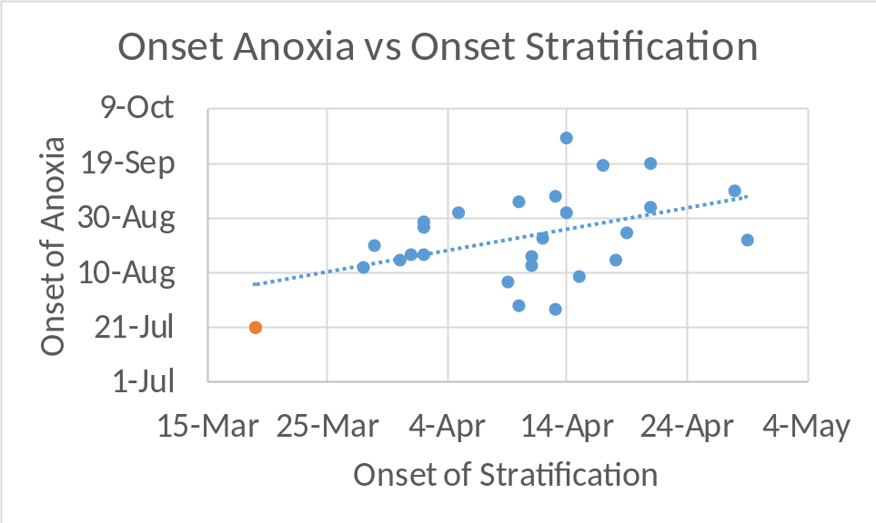
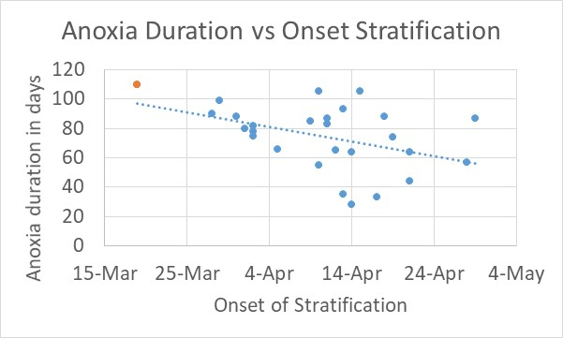
Relationship between stratification onset and anoxia
Linear regression statistics:
this analysis (black)
Woodard’s analysis (gray)
slope = 0.57; p = 0.04; r² = 0.16
slope = 0.60; p = 0.05; r² = 0.19
slope = -0.67; p = 0.07; r² = 0.12
slope = -0.88; p = 0.02; r² = 0.27
Notes:
Anoxia onset range 69 days
Anoxia duration range 82 days

Slide 12
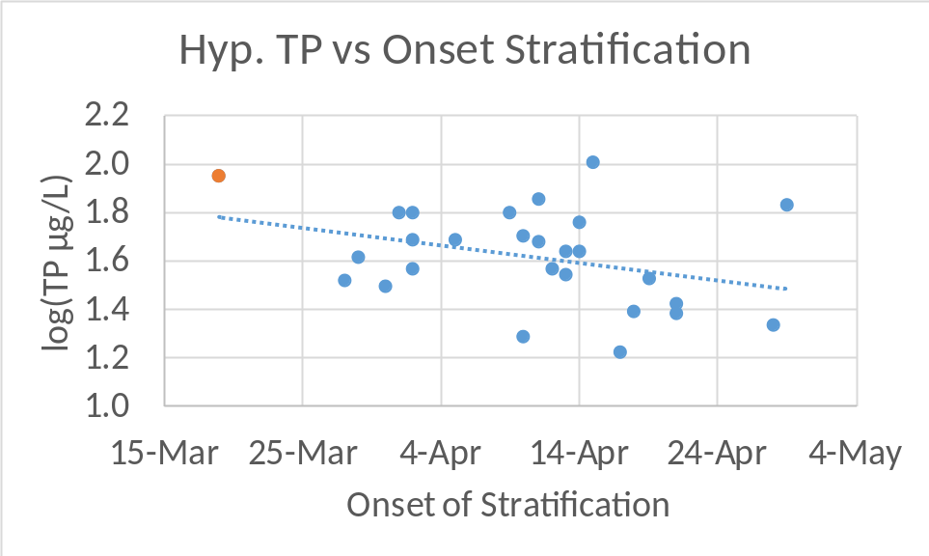
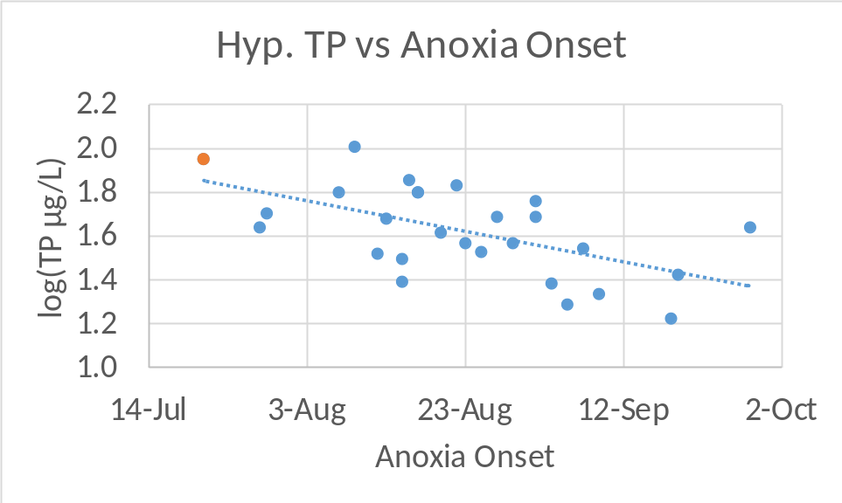
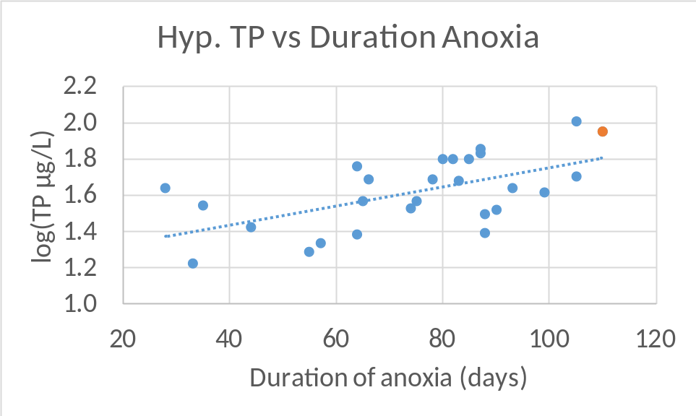
Relationships with hypolimnetic phosphorus
slope = -0.005; p = 0.15; r² = 0.08
slope = -0.007; p = 0.002; r² = 0.32
slope = -0.01*; p = 0.005; r² = 0.37
slope = -0.01*; p = 0.02; r² = 0.28
Linear regression statistics:
this analysis (black)
Woodard’s analysis (gray)
* slopes reported as µg/L/day
slope = 0.005; p = 0.001; r² = 0.34
slope = 0.01*; p = 0.02 ; r² = 0.26
Notes:
TP range 17-102 ug/L (85)
Recall onset of stratification ranges over ~53 days
2002 we observed relatively high TP with a later onset of stratification

Slide 13
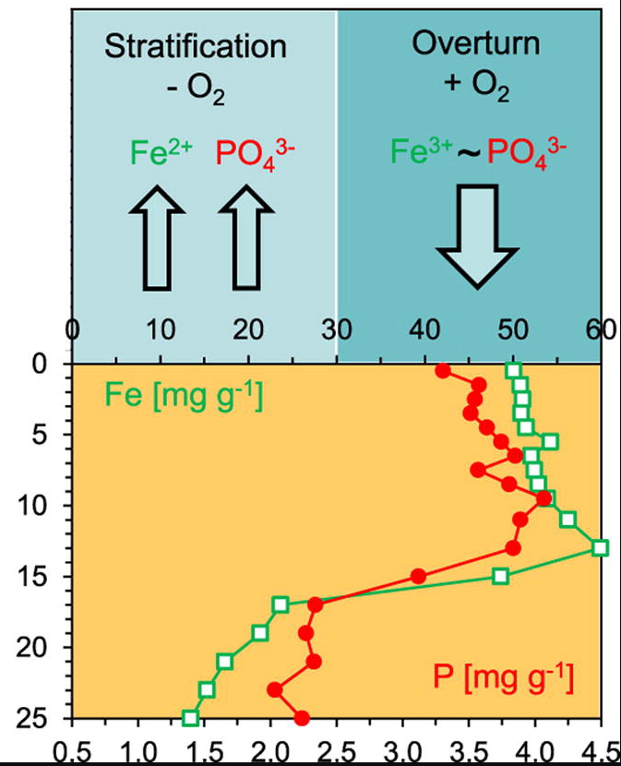
Implications for Lake Sammamish
Maybe not much…at least for now
  Iron control of hypolimnetic phosphorus during fall turnover
Balistrieri, L.S. et al. 1992. The cycling of iron and manganese in the water column of Lake Sammamish, Washington. Limnol. Oceanogr. 37:510-528.
See also: Barnes (1976), Welch (1977)
Kleeberg, A. et al. 2013. Water Research 47:1491-1502.

Slide 14
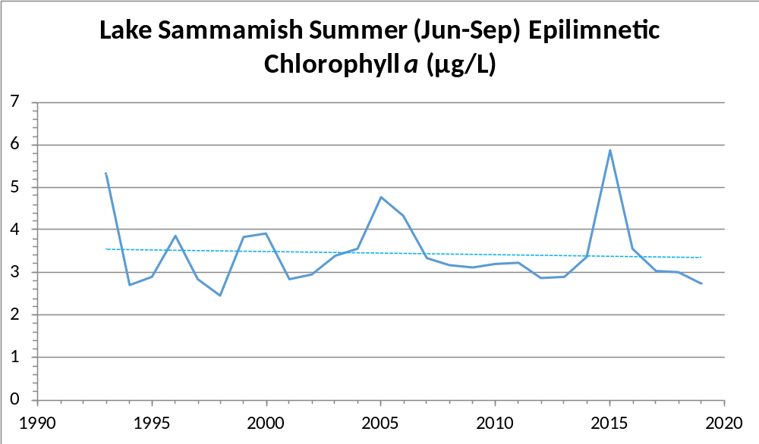
Summer (Jun-Sep) trophic trend

Slide 15
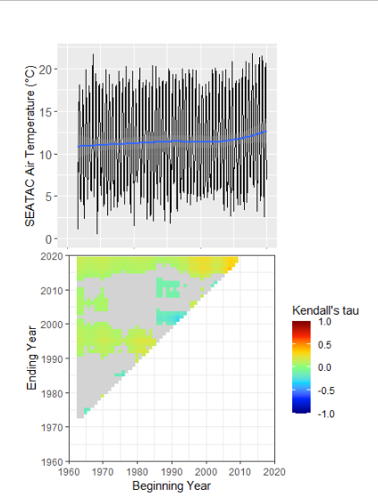
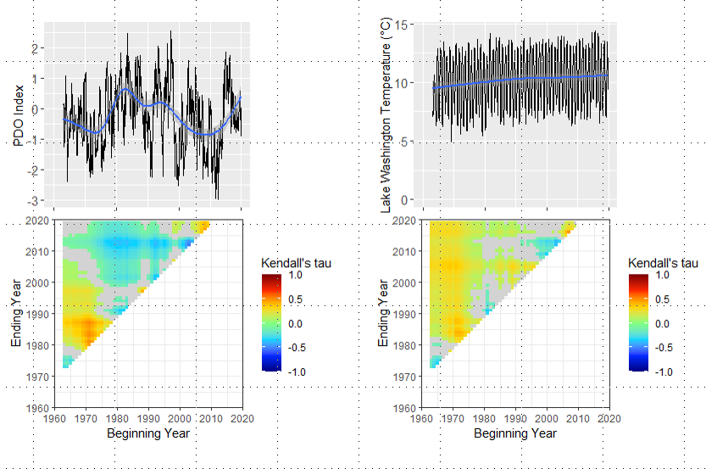
Climate change? – need longer data sets
Lake Washington*
*Lake Washington temperature data courtesy of Arni Litt – University of Washington Dan Schindler’s Lab

Slide 16
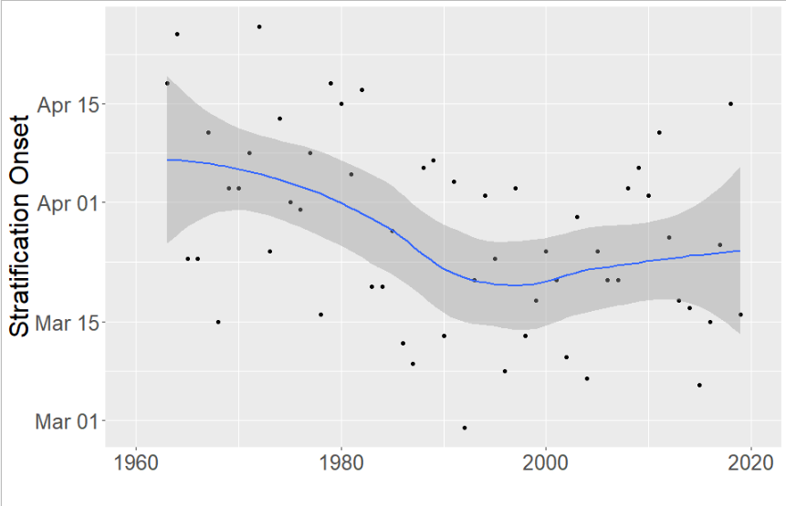
Trend in Lake Washington stratification onset date
Winder, M. and D.E. Schindler. 2004. Climatic effects on the phenology of lake processes. Global Change Biology 10:1844-1856.

Slide 17
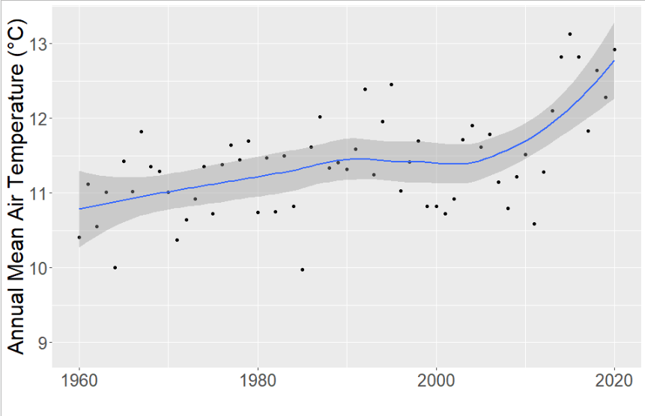
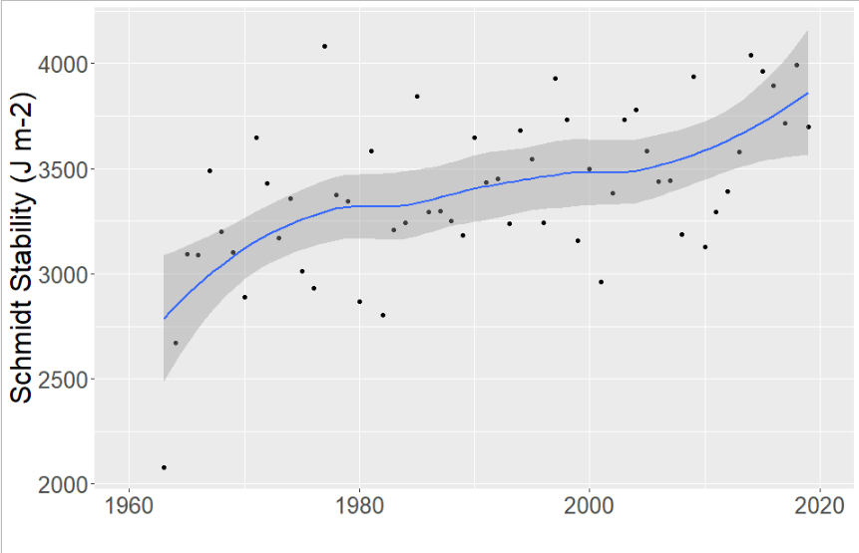
Air temperature and lake thermal stability trends
Annual mean air temperature
Sea-Tac Int. Airport
Annual maximum thermal stability
Lake Washington

Slide 18
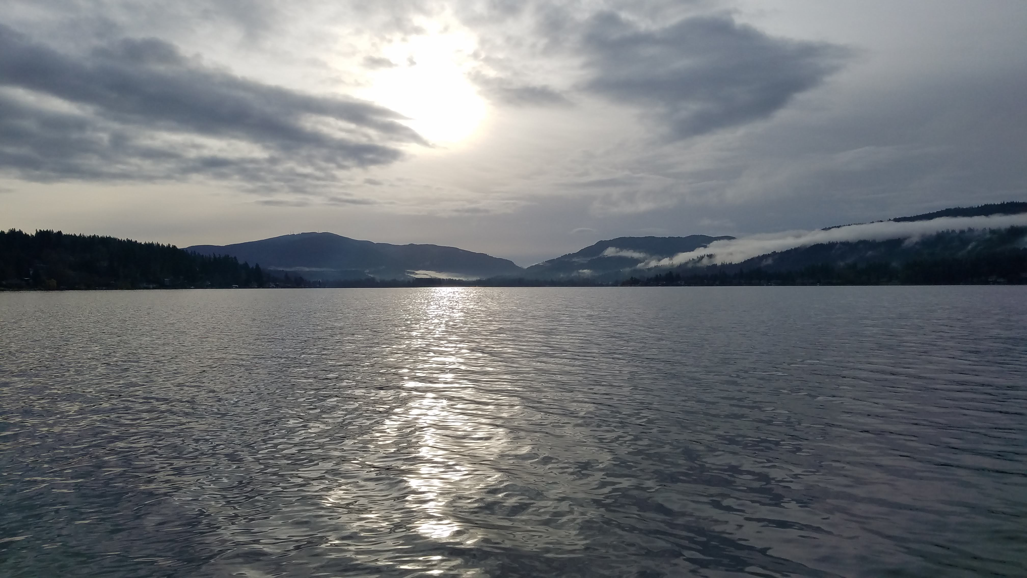
Questions?
E-mail: curtis.degasperi@kingcounty.gov
Lake Sammamish looking south
November 26, 2019

